Slide 1

Azure in CSP: Program overview

Slide 2
Cloud Solution Provider (CSP) – innovative business model for Microsoft Partners.
Microsoft Azure
Sell Microsoft cloud services for business with your added value
Sell Integrated Offers and Services
Own and Control the Billing
Office 365
Dynamic 365
Own customer relationship
Provision Manage and Support
Enterprise Mobility Suite

Slide 3

Azure in CSP enables partners to…
Set the price, the terms and directly bill customers
Directly provision, own and manage Azure subscriptions
Be the first point of contact for customer support
1
2
3
4
Create cloud subscription + partner offer
Set package price and sell to customers
Place order for Microsoft Cloud Services
Offer single packaged solution

Slide 4
One program, two different business models
CSP Direct model (1-tier)
Partner works with Microsoft directly
Fixed discount for Azure
Partner needs to provide billing tools and build support practice
Credit check during the onboarding process
CSP Direct
CSP Indirect
Microsoft
Microsoft
CSP Indirect Provider
CSP Indirect model (2-tier)
2 partner tiers:
CSP Indirect Provider (aka Distributor) – transacts to Microsoft, provides billing tools and technical support.
CSP Indirect Reseller – sells Azure to customers through CSP Indirect Provider.
CSP Direct Partner
CSP Indirect Reseller
Customer
Customer
Choose your path – enroll today.

Slide 5
Partner Center Portal
partnercenter.microsoft.com
Core of partner’s CSP business. Manage Azure customers in one place.
Partner Center Key Capabilities
Easy to Use web portal
Provision Customers & Subscriptions
Admin-on-behalf-of customers
Office 365, EMS, Dynamics 365, Azure
Multi-channel & Multi-partner capabilities
Automated invoicing
Rich set of APIs for integration
CSP Content & Resources

Slide 6
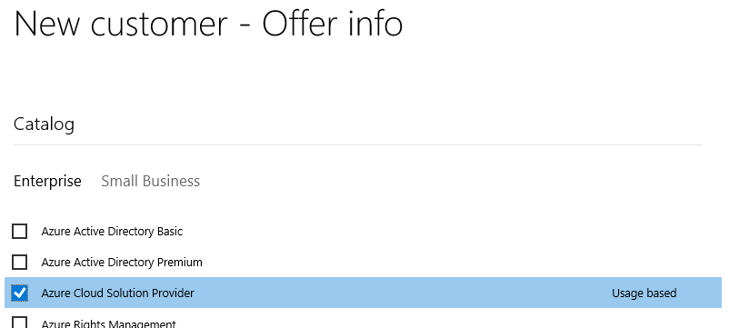
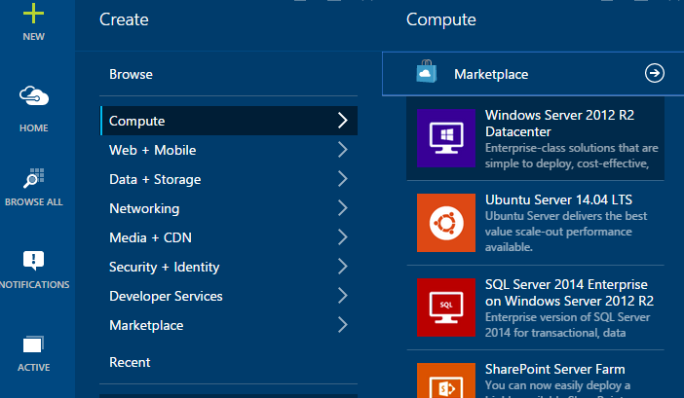
Selling Azure through CSP
Partner establishes customer relationship and “sells” Azure subscription
Services are created in the Azure Management portal
Usage occurs over the month
Microsoft bills the partner for the usage
Partner bills the customer for the usage
Microsoft Azure

Slide 7
Types of CSP Partners
Hosting Service Providers
System Integrators
License Resellers and distributors
Telcos
Hardware Resellers and distributors
ISVs
IT Outsourcing companies
Dynamics partners

Slide 8

What Azure CSP Partners usually sell
Managed Cloud Services
Azure Subscription with support services from a partner
Infrastructure solutions on top of Azure services
Managed Backup to the Cloud
Disaster Recovery as a Service
Cloud Storage
Business Applications, deployed on Azure platform
Dynamics solutions
SharePoint solutions
3rd party business applications
Data Analytics and IoT solutions

Slide 9
Azure CSP Practices
What partners need to build to be successful in Azure CSP
1. Technical support practice
2. Billing practice
3. Deployment services practice
4. Cloud sales practice
CSP Direct partners get discount for Azure to implement it
CSP Indirect Reseller receives it from CSP Indirect Provider (Distributor)

Slide 10
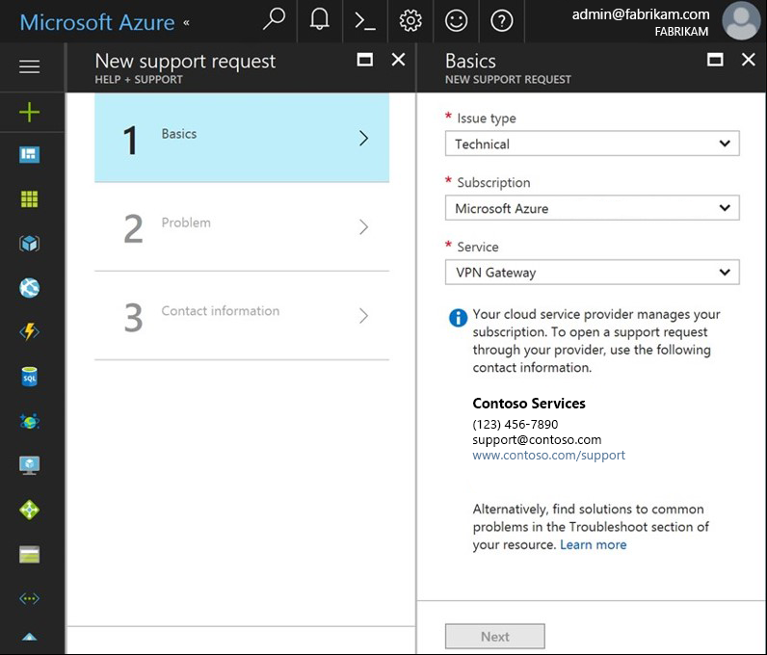
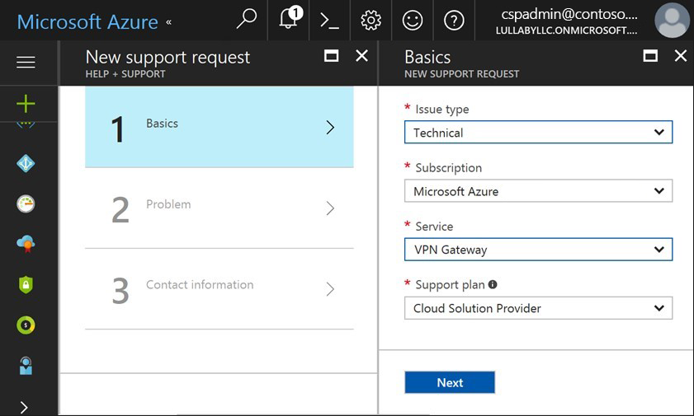
Microsoft doesn’t provide any support to CSP Customers.
Customer view
CSP Partner view

Slide 11
Technical support for Azure services
1
2
3
4
Register a new customer request in the own tracking system
1st tier of support:
Do basic troubleshooting
Check if there are any related service issues on Azure Resource Health
Provide solutions to the customer
2nd tier of support:
If problem is not resolved – escalate the request internally and do deep troubleshooting
Ensure that the environment is fully supported by Microsoft
Provide solutions or fix the problem in on behalf the customer
Escalate issues to Microsoft
Only after steps 1-3 (details)
Microsoft provides different support options for CSP Partners
All escalation requests are still managed by the partner.

Slide 12
Support options for CSP Partners
Advanced Support for Partners (ASfP)
Premier Support for Partners (PSfP)
Included with CSP
Submit Support Tickets On Behalf of End Customer | ✓ | ✓ | ✓
Support Account Management | No dedicated manager | Assigned from a regional pool | Designated support manager (TAM)
Technical break-fix | Through portal | Through portal + e-mail + phone | Through portal + e-mail + phone
Case Severity & Target Initial Response Times | Sev A: 2h Sev B: 4h Sev C: 8h | Sev A: 1h Sev B: 2h Sev C: 4h | Sev A: 1h Sev B: 2h Sev C: 4h
24x7 Critical Situation Support | -- | -- | ✓
Advisory “How To” Services | Requires MPN Silver/Gold competency | ✓ | ✓
Technical Presales Assistance | Requires MPN Silver/Gold competency | ✓ | ✓
CSP Integration Support | -- | Packaged | Customizable
Proactive Support Services | -- | Packaged | Customizable
 | Details | Details | Details

Slide 13
Pricing and billing of Azure services
Manage Azure pricing
Manage Azure billing
1
2
Set an end-customer price for Azure services
Provide guidance for pricing rules of different Azure services
Calculate the estimated monthly cost for customer workloads in Azure.
Define the billing rules between end-customer and CSP Partner
Provide consumption analysis capabilities to customers
Pay invoice from Microsoft (CSP Direct) or from Distributor (CSP Indirect) based on the consumption of all customers
Manage billing disputes and escalate billing issues to Partner Center support team.

Slide 14
Next steps
Want to become a CSP partner? Join CSP today.
Want to learn more about Azure in CSP? Read here.

